Slide 1
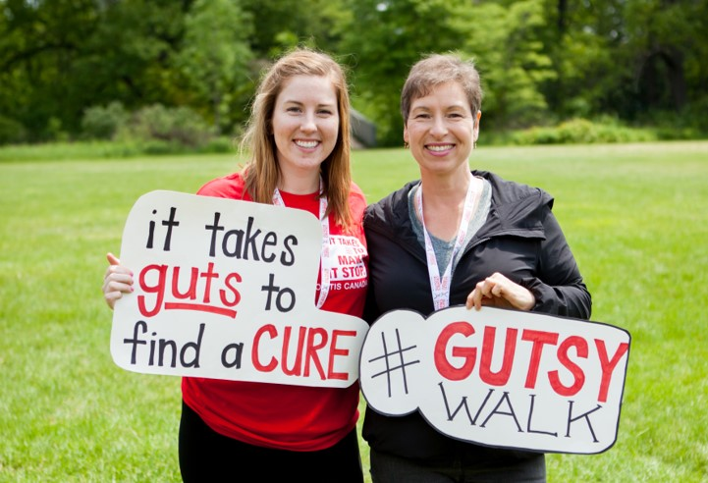
With your help, Cures are Steps Away

Slide 2



Agenda
1
OVERVIEW
About Crohn’s and Colitis
About Gutsy Walk
2
LEAD THE WAY TO THE CURE
Your impact as corporate teams
Fundraising
3
NEXT STEPS
Together, cures are steps away
Notes:
Today we are here to invite you to stand out in the community as leaders in finding a cure for Crohn’s disease and ulcerative colitis. Our agenda for today….

Slide 3
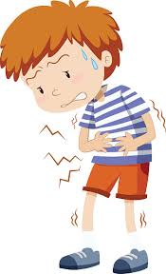
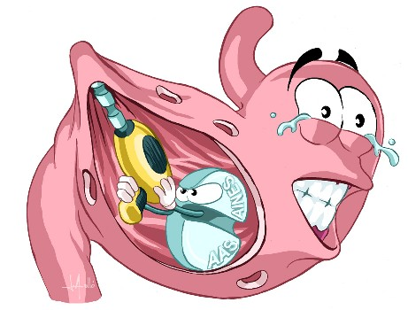

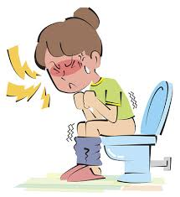
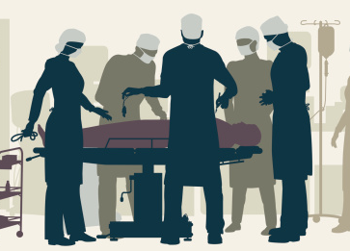
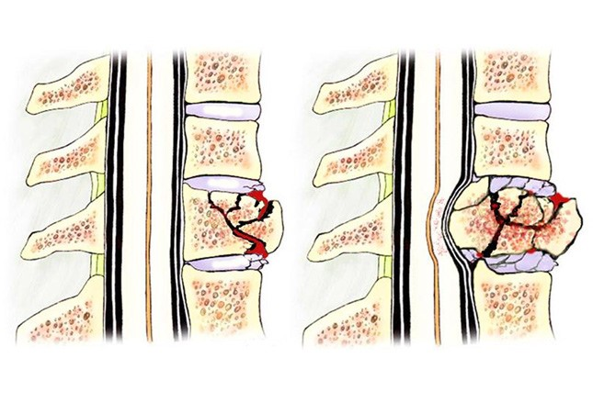
What are Crohn’s and Colitis?
Debilitating pain, loss of digestive function, diarrhea, malnutrition
Immune system attacks the
digestive tract
Causes inflammation, ulcers and intestinal scarring
Can lead to repeated hospital visits, multiple surgeries, removal of colon.
Complications involve: osteoporosis, liver, skin joints, eye sight, growth and height, weight, mental health, depression and anxiety.
For young children, these diseases are often more aggressive
Notes:
For those of you that may not be as familiar with Crohn’s and colitis, they are diseases that inflame the lining of the GI, or gastrointestinal tract. They are the forms of inflammatory bowel disease (IBD)
They can disrupt your body’s ability to digest food and absorb nutrition, and eliminate waste in a healthy manner.
These are lifelong diseases, and they affect so many aspects of life, from school to careers to relationships.

Slide 4

How Crohn’s and Colitis Affect Us
CANADA HAS AMONG THE
HIGHEST RATES
of Crohn’s & colitis in the world
NEW CASES IN CHILDREN HAVE ALMOST
DOUBLED
CROHN’S AND COLITIS COST CANADIANS
$2.8 BILLION
1
since 1995
EVERY
HOUR
annually
is diagnosed with Crohn’s disease or ulcerative colitis in Canada
MORE THAN 2x
1ST GENERATION
as common as Multiple Sclerosis & Parkinson's disease; as common as Type 1 diabetes or epilepsy
Families new to Canada are developing Crohn’s or colitis for the first time – often within the first generation

Slide 5
Crohn’s and Colitis Canada
Our Promise
To cure Crohn’s disease and ulcerative colitis and improve the lives of children and adults affected by these chronic diseases.
Our Mission
Invest in
Increase public
RESEARCH
EDUCATE
AWARENESS
ADVOCATE
to foster advances in prevention, treatments, cures and health policy
patients, families, industry and governments about these diseases
of Crohn’s and colitis and our organization
to governments and stakeholders on behalf of those affected by these diseases
We are the ONLY national charity focused on:
FINDING THE CURES
IMPROVING THE LIVES
  for Crohn’s disease and ulcerative colitis
  of children and adults affected
Notes:
Here’s an overview of the mission of Crohn’s and Colitis Canada

Slide 6


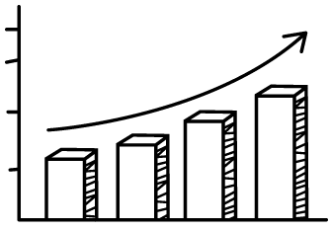





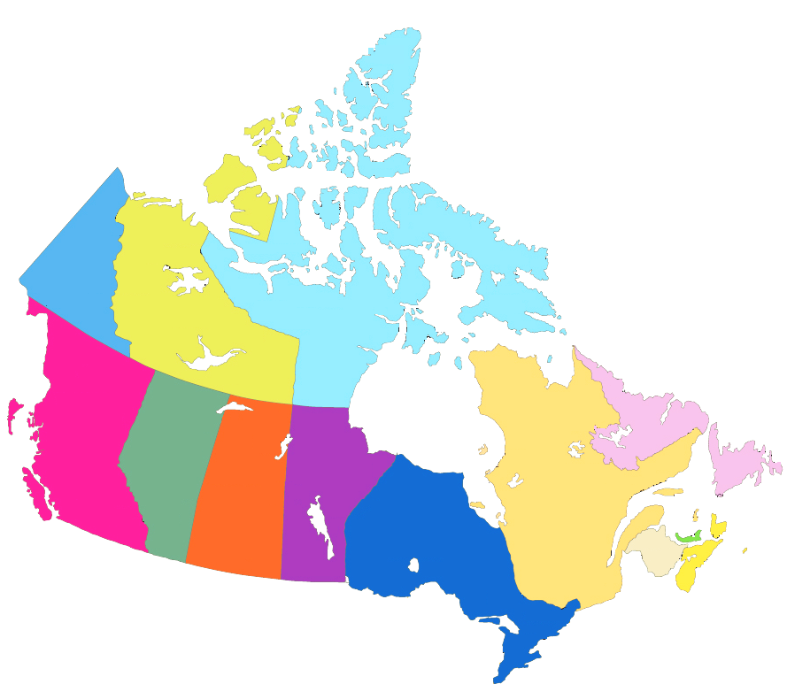













What is Gutsy Walk?
WHAT IS GUTSY WALK?
60+
walk locations across Canada
$3.65M
2018 goal from $240,000 in 1996
24%
Largest source of revenue for CCC
$35M +
Raised for research & patient programs since 1996
Led by volunteers supported by CCC staff
All events across Canada will be held on Sunday, June 3
CCC’s largest and most energetic fundraising event.
Powered by volunteers
Notes:
The Gutsy Walk takes place on Sunday, June 3, 2018 at over 60 locations across Canada. Every walk is fun-filled, family-friendly, and non-competitive. Route lengths vary, but are typically five kilometers. Participants can walk any distance they’re comfortable with.
This is Canada’s largest community fundraiser for Crohn’s and colitis. Since 1996, the Gutsy Walk has raised over $35 million for research and patient programs, all thanks to participants, donors, and sponsors who are driven to make a difference.
Every dollar you raise through the Gutsy Walk helps Crohn’s and Colitis Canada’s efforts to:
Raise awareness of the diseases
Provide support for patients and their families
Advocate to governments and stakeholders on behalf of those affected by Crohn’s and colitis
Fuel research that will lead to more effective treatments, and ultimately, the cures.

Slide 7
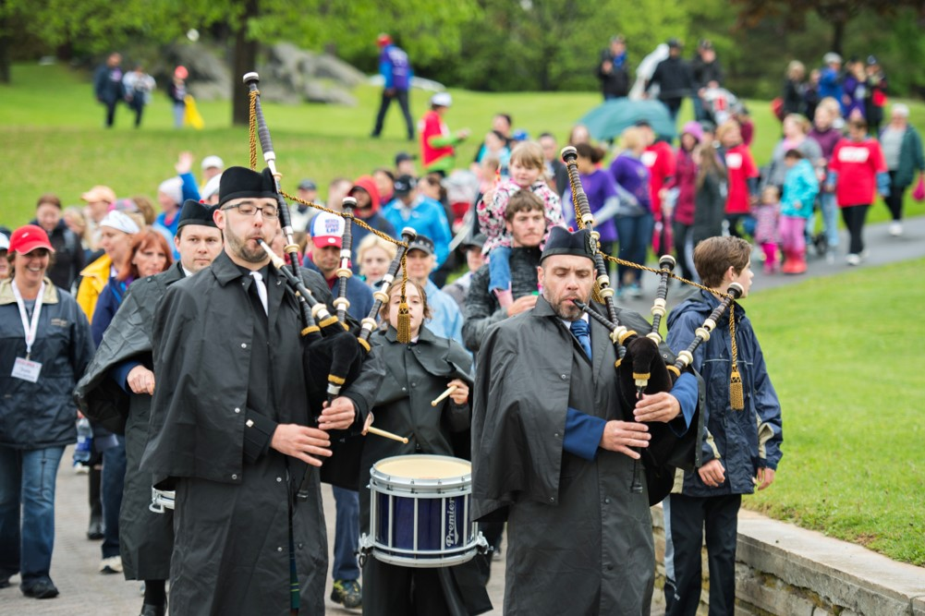

What is Gutsy Walk?
Communities across Canada UNITE
to find a cure.
Notes:
Every year, survey responses point out that the best thing about the event is the community feel, where people feel that they are not alone. Let us prove them right.

Slide 8
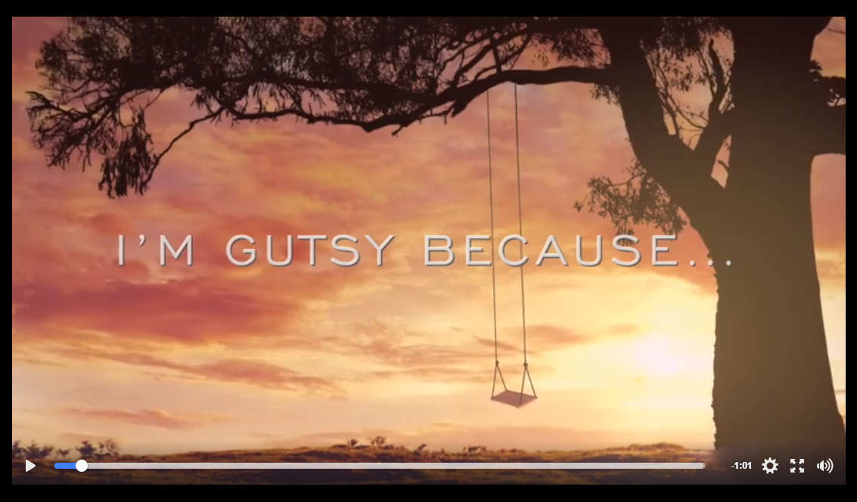
Impact as a Corporate Team
https://www.facebook.com/mjmckechnie/videos/vb.1371166366/10212778242555509/?type=2&theater
Notes:
Make “more” possible
For Gutsy Walk 2017, CCC asked Gutsy Walk participants why they walk, why are they Gutsy.
Let’s watch Marnie’s response. <after the video>
Through your participation, you will make it possible to have more Marnies out there. Your participation will give hope in research breakthroughs, hope in obtaining the best treatments, hope in getting more peer support, and hope that we will find a cure.

Slide 9



Impact as a Corporate Team
The Power of Giving Back
Lead the way
Amplify employee team spirit when you collaborate and inspire for a good cause
Let your team be a leader in finding cures for Crohn’s and colitis
Build community relationships
Increase networking
Positive brand image
Notes:
As individuals, giving back to our communities makes us feel good, causes us to be more socially aware, and helps us bond with our colleagues as we team up to help those in need. In the quest for a great work-life balance, it is important to many A-list candidates to be employed by a company that gives to charity for these very reasons
Consumers appreciate and support socially conscious businesses because it causes them to become emotionally invested.

Slide 10
Fundraising Incentives
Participant Raises: | Participant Receives:
$100+ | Gutsy Walk T-shirt*
$250+ | $10 Gift Card* + T-shirt
$500+ | $25 Gift Card* + T-shirt
Top Pledge Earner Club (TPE)
$1,000+ | $85 Gift Card* + TPE Gift
$2,500+ | $200 Gift Card* + TPE Gift
$5,000+ | $400 Gift Card* + TPE Gift
$10,000+ | $850 Gift Card* + TPE Gift
Notes:
When you fundraise for Gutsy Walk, you are entitled to receive prizes.

Slide 11
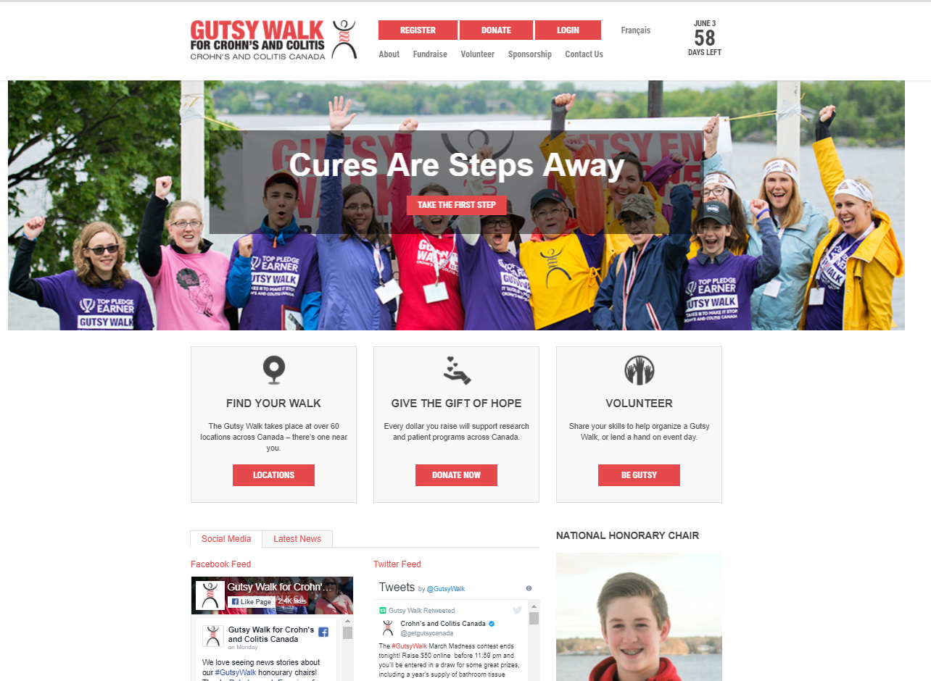
Online Fundraising
Notes:
Simply visit gutsywalk.ca and select Register ☺

Slide 12
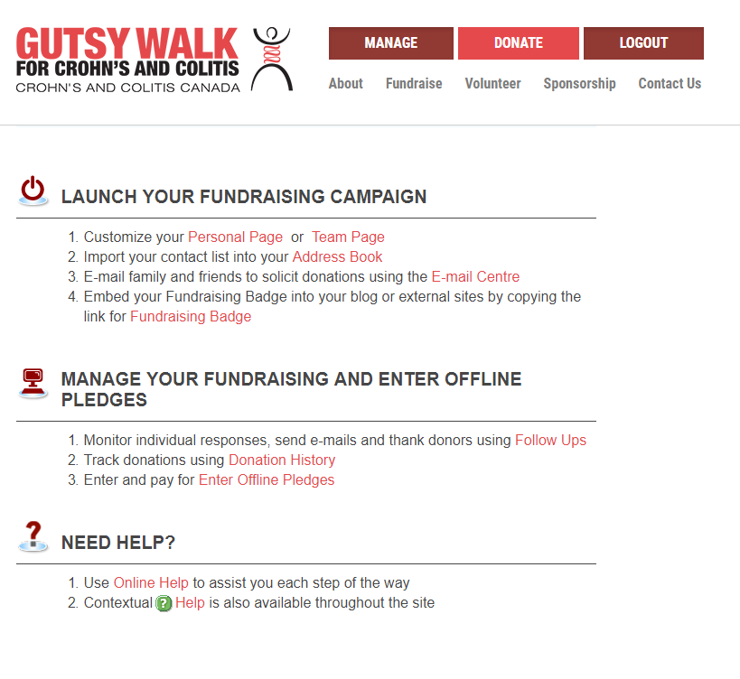
Online Participant Centre
The Online Participant Centre helps you ask your family and friends for their support.
You can create your own fundraising page and share it by email or through social media.
It has pre-written emails that are also fully customizable so you can personalize them.
Notes:
Once you register, you will set your own username and password and this gives you access to the Online Participant Centre. This helps you ask your family and friends for their support.
You can create your own fundraising page and share it by email or through social media.
It has pre-written emails that are also fully customizable so you can personalize them.
Choose the message you want to send, select the email addresses you would like to contact and you’re set!
It’s a quick and easy way to kick-start your fundraising and share your progress.

Slide 13

Corporate Team Visibility
T-shirt
Sticker
Notes:
This is the Gutsy Walk T-shirt that will be provided to Take Corporate Team members. If all your members register by May 11, we can ship the shirts earlier to you so you have them before walk day.
You will also receive a Corporate Team sticker that we can put on our shirts to make us stand out, and also so we can get our photos back to us.

Slide 14
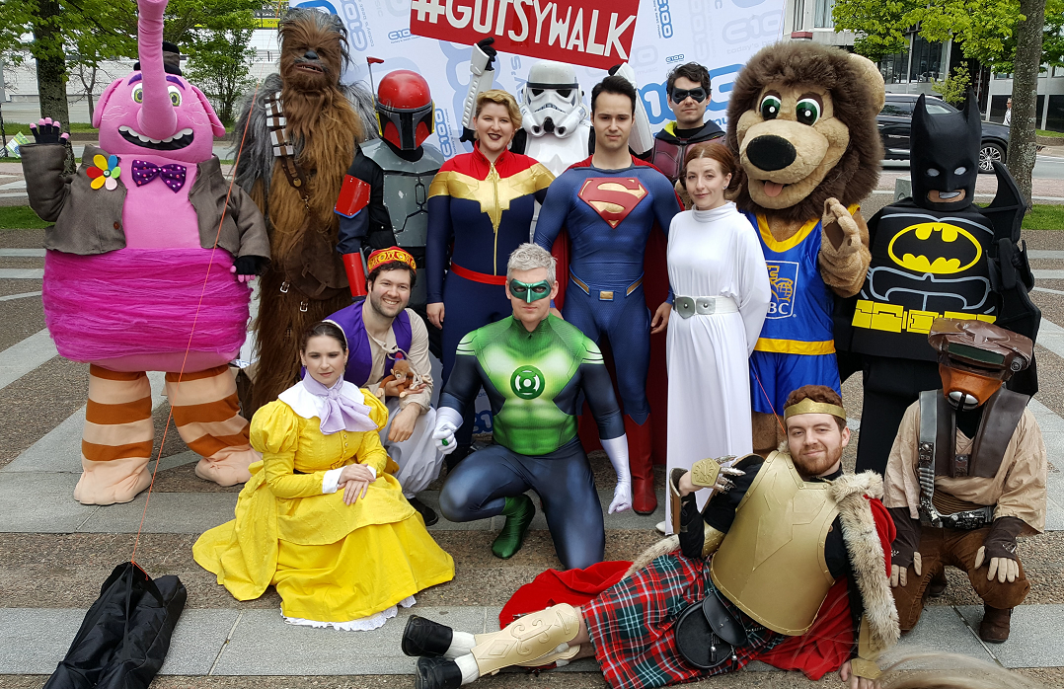
Corporate Team Visibility
Notes:
Have fun on event day! You can either wear your Gutsy Walk shirts, your team shirts, or costumes!

Slide 15

Cures Are Steps Away
Resources from Crohn’s and Colitis Canada:
Fundraising Tools
  Team Captain Checklist
  Fundraising tips and ideas
  Pledge Form
  Kickoff agenda template
  Team Thermometer
Dedicated CCC partner
  Haidee Zapanta, Gutsy Walk National Manager
    hzapanta@crohnsandcolitis.ca
Your Impact
  A report about your impact that you can share
Notes:
Add here your next steps in rolling out the campaign.

Slide 16

See You There!

